Slide 1
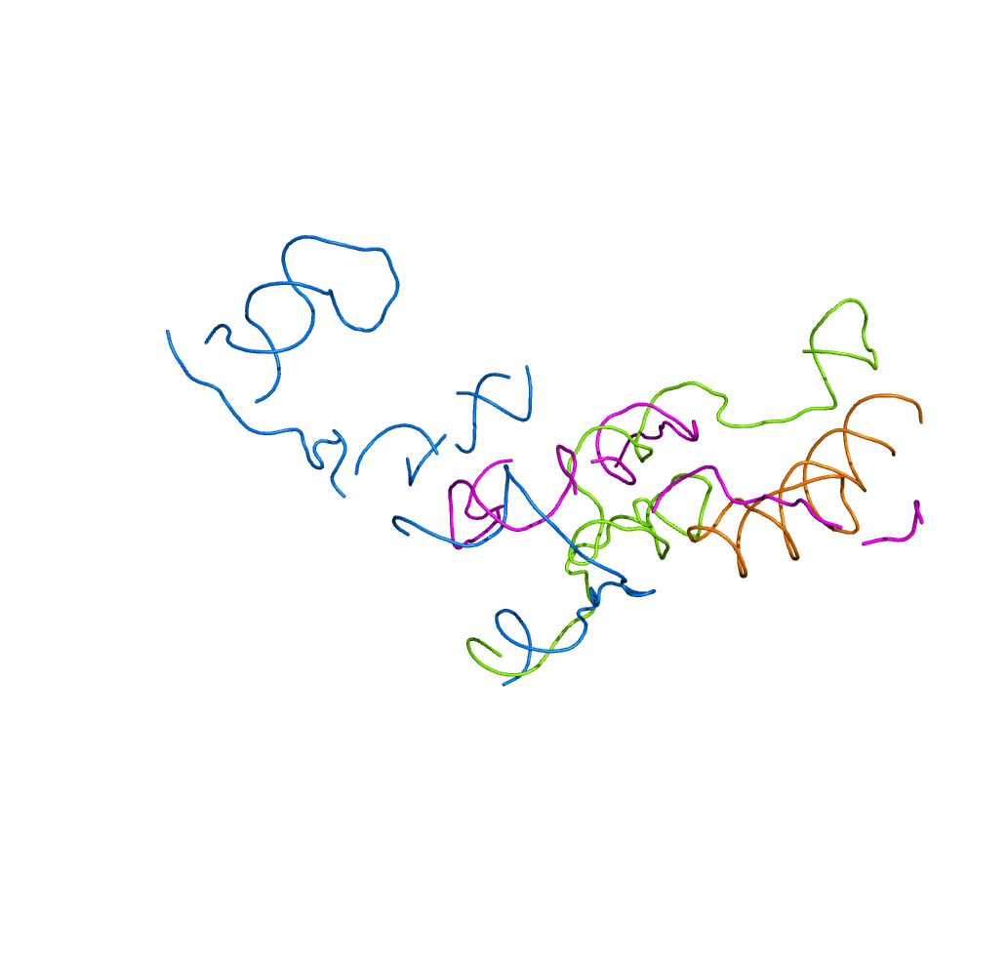
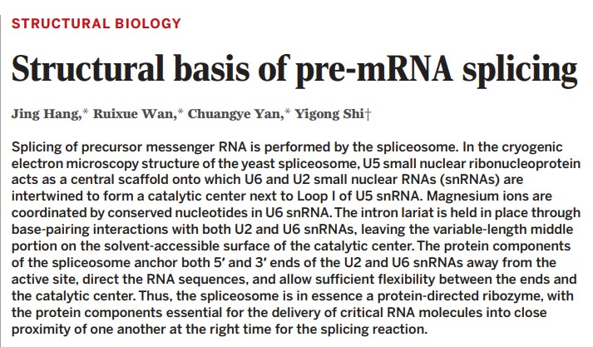
Shared by 郑昊田

Slide 2
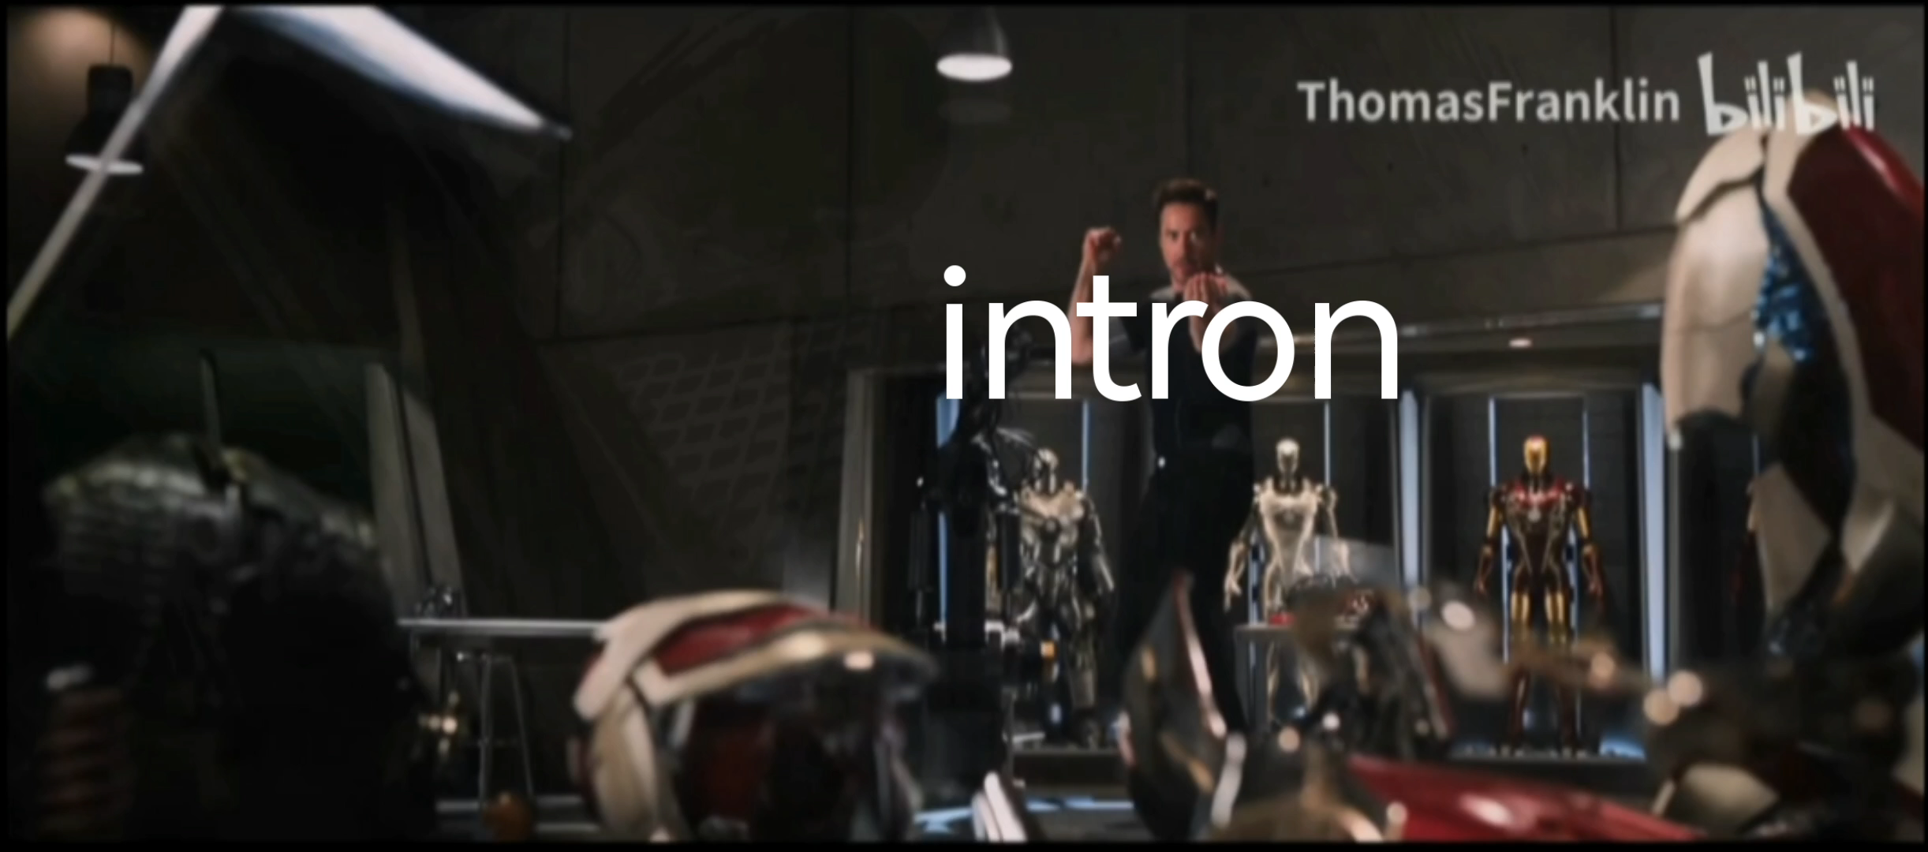

Slide 3


Slide 4
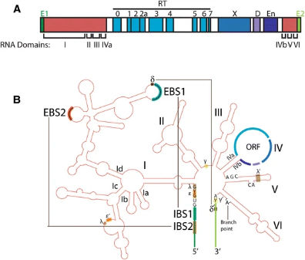
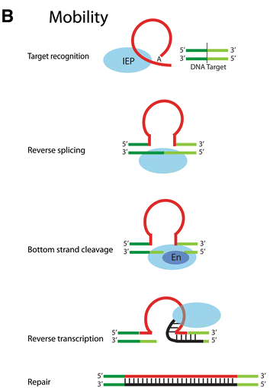


Slide 5
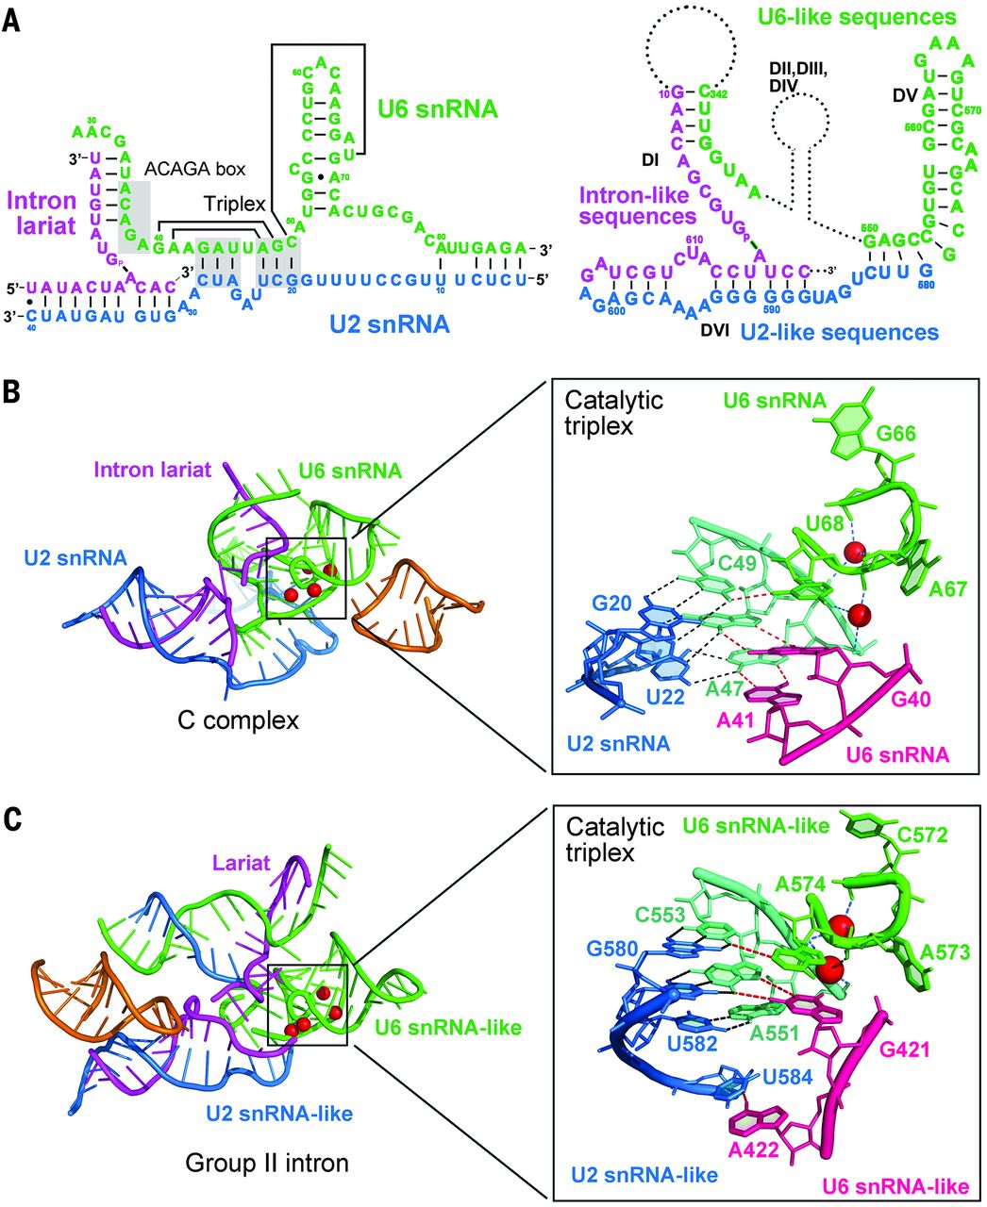


像，很像啊

Slide 6
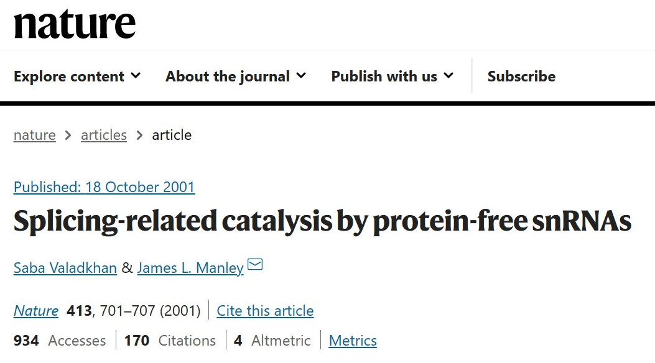
RNA of Spliceosome

Slide 7
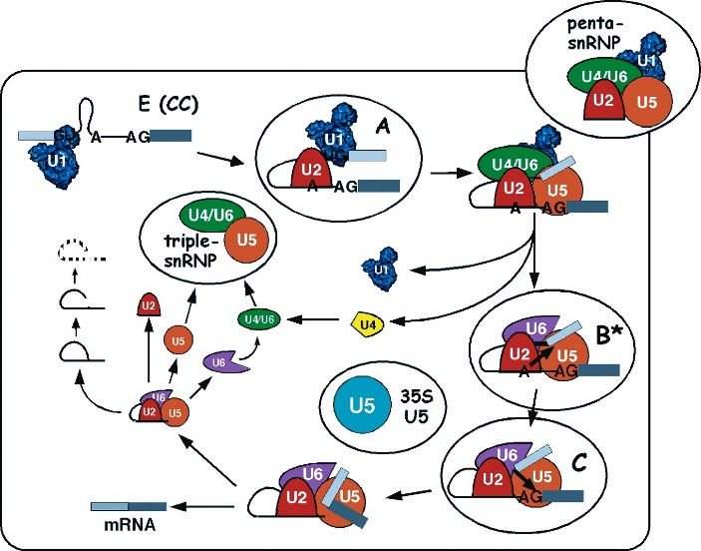
Protein of Spliceosome

Slide 8
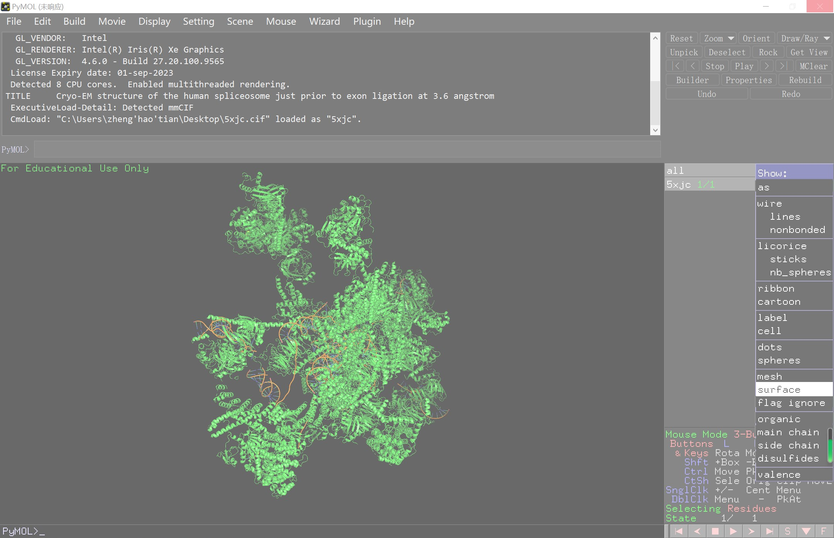
Protein of Spliceosome
Distinguish containments:
Filtrate and Lost
“It is nuggets like this that spur prospectors to roll up their sleeves and get back to the lab bench to flesh out the functions of these new splicing factor candidates.”

Slide 9
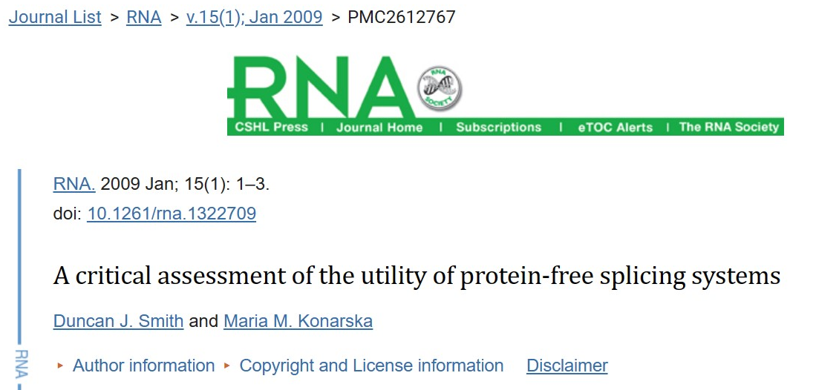
Further investigation should clarify the coordination and precise mechanistic roles of divalent ions in the spliceosome
A similar active site arrangement can be found in catalytically active RNase H domains (from Prp8):
Regardless of Prp8's direct contribution to catalysis, we believe that the intimate involvement of this and other proteins means that, even if the metal ions required for splicing catalysis are coordinated entirely by groups from snRNAs, the spliceosome should still be considered an RNP with an RNA active site, rather than a ribozyme.

Slide 10
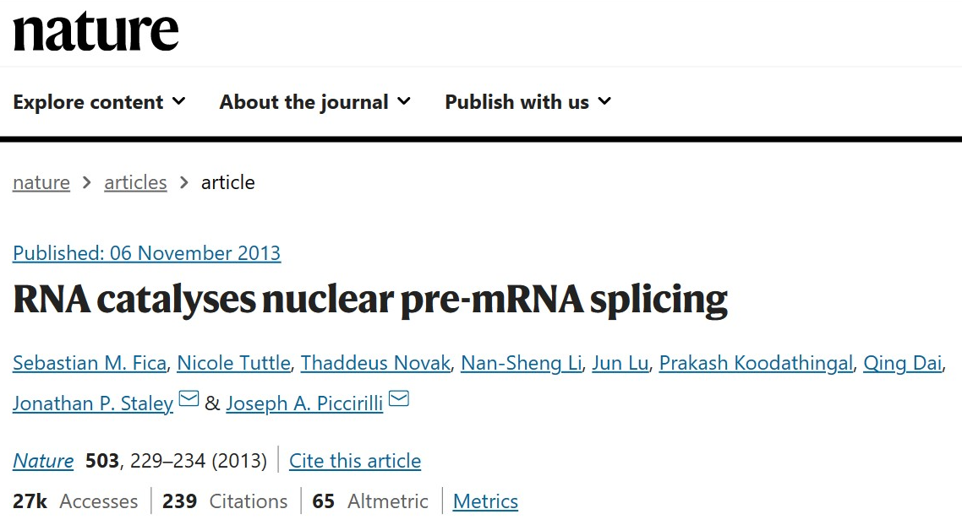
Mechanism of divalent ions
2013: Spliceosome is a ribozyme

Slide 11
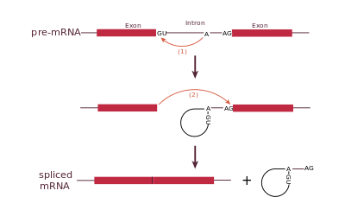
Mechanism of divalent ions

Slide 12
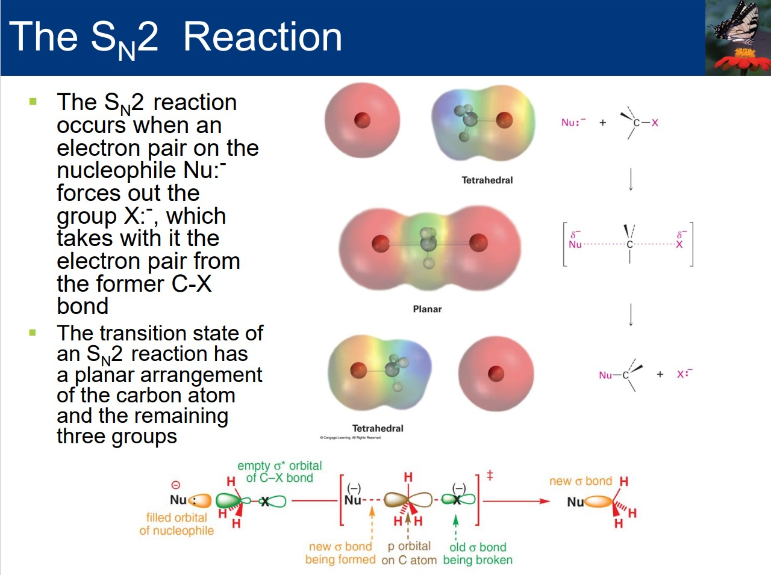
Mechanism of divalent ions

Slide 13
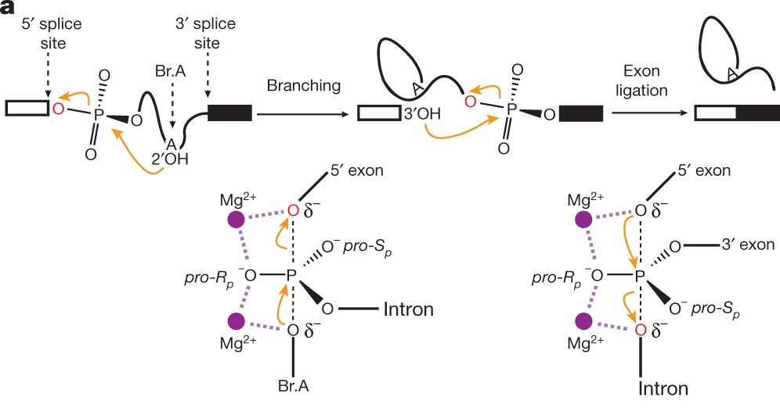

Mechanism of divalent ions

Slide 14
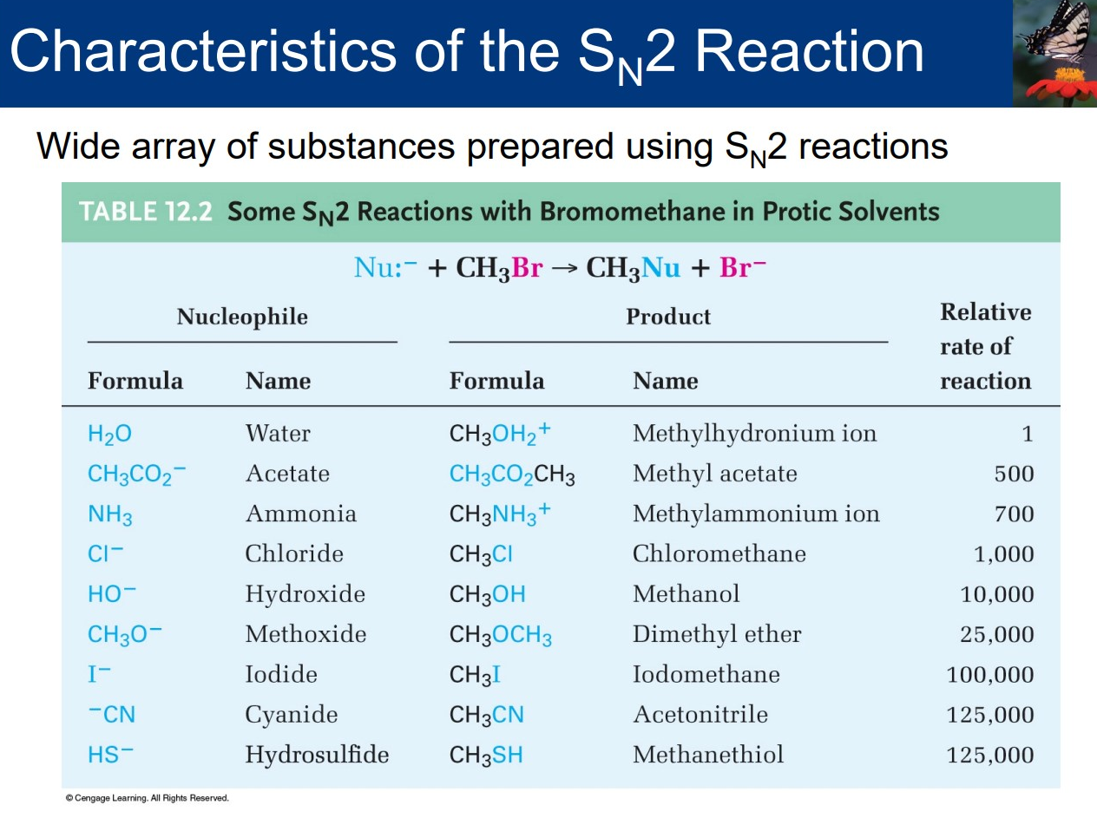
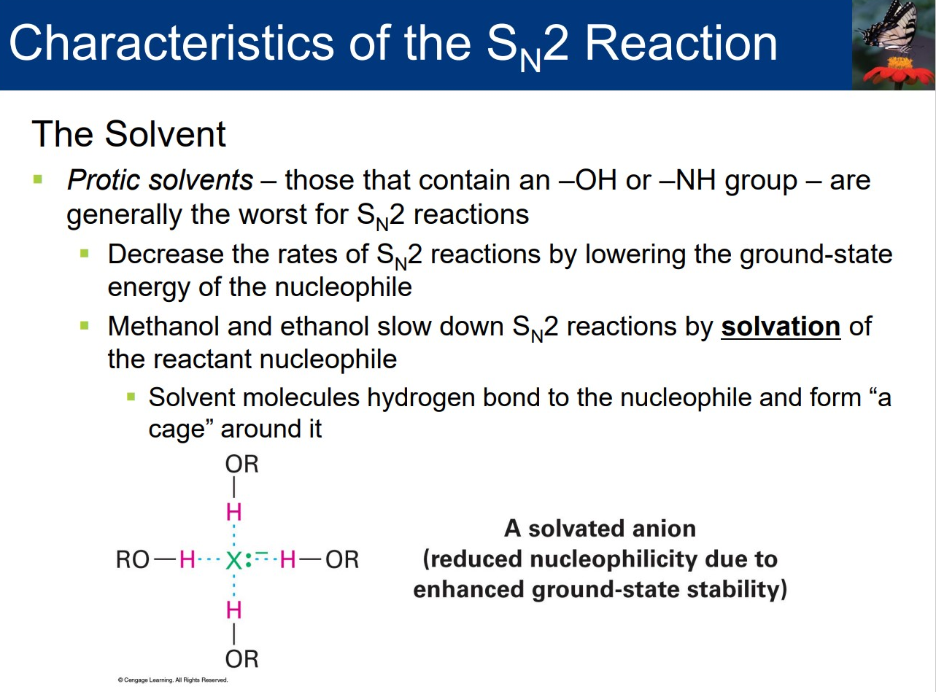
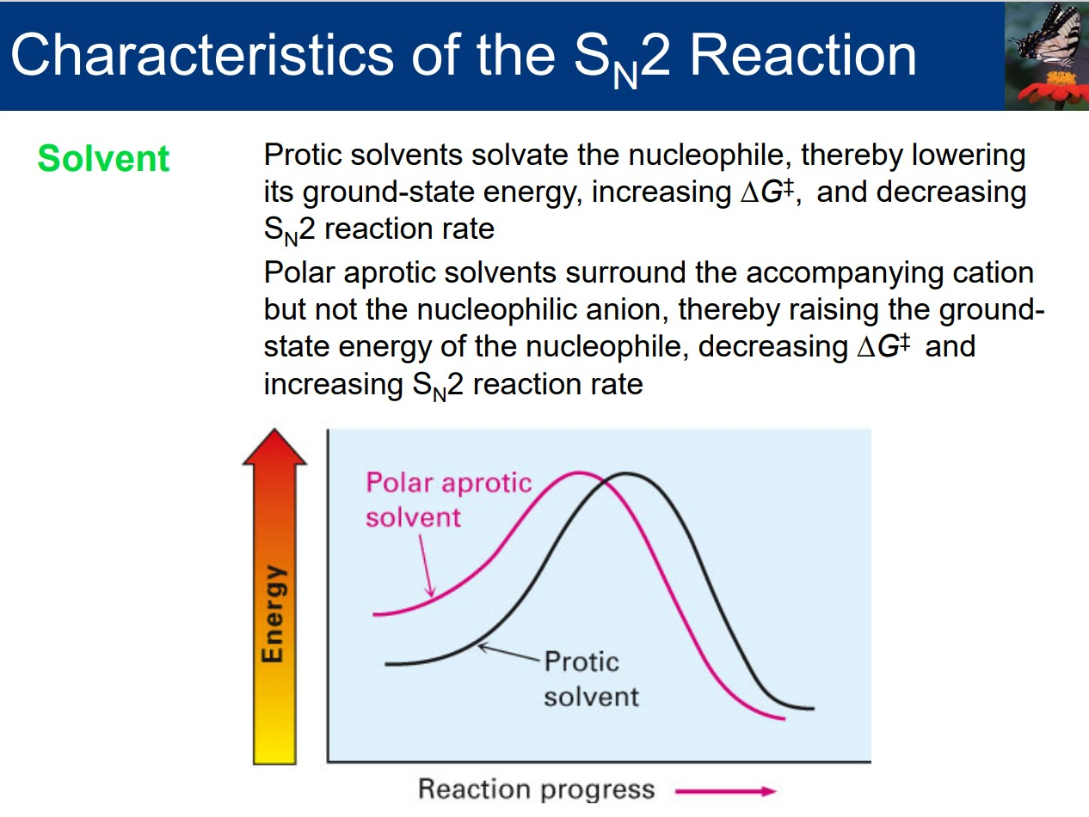
Mechanism of divalent ions

Slide 15
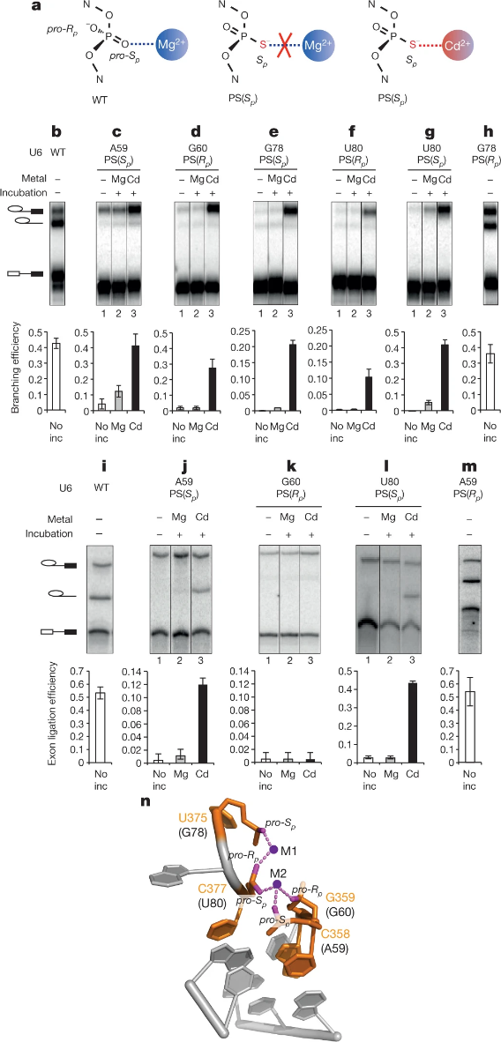

Mechanism of divalent ions

Slide 16
Mechanism of divalent ions

Slide 17

Mechanism of divalent ions

Slide 18
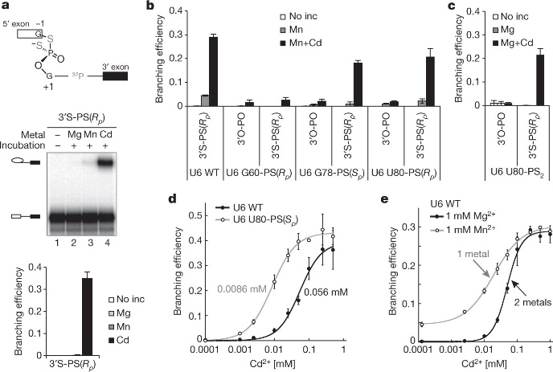

Mechanism of divalent ions

Slide 19



Mechanism of divalent ions

Slide 20
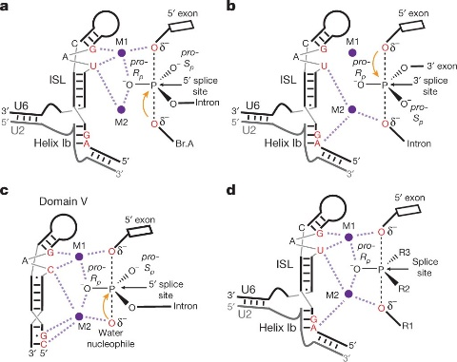
Mechanism of divalent ions

Slide 21
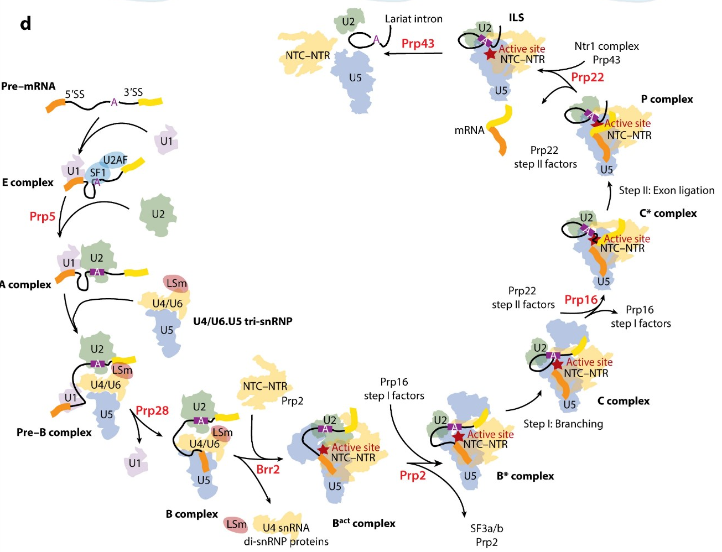


Wilkinson ME, Charenton C, Nagai K. RNA Splicing by the Spliceosome. Annu Rev Biochem. 2020;89:359-388. doi:10.1146/annurev-biochem-091719-064225

Slide 22
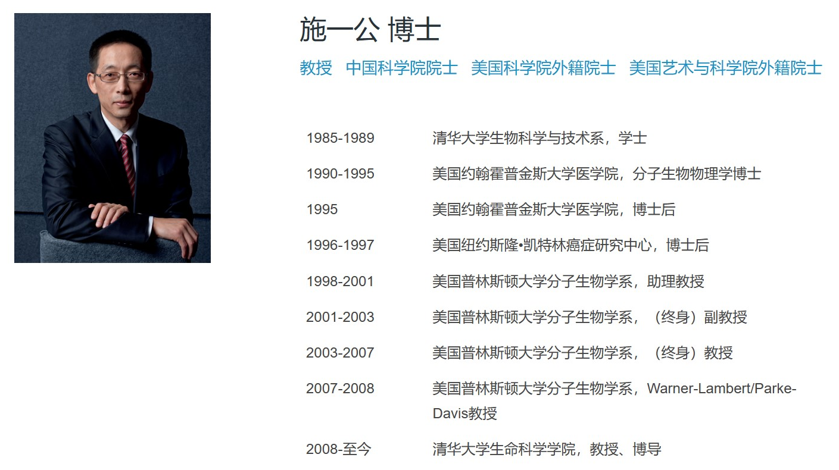

Slide 23
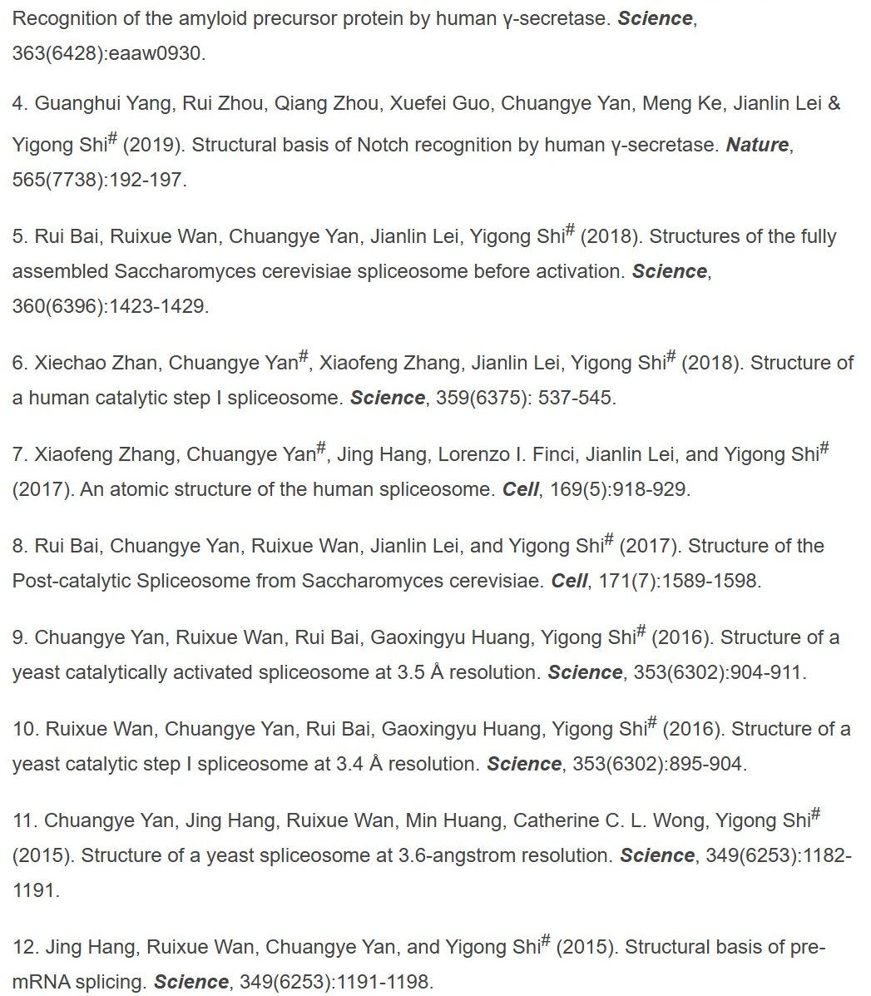

Slide 25
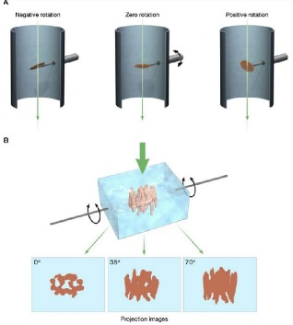
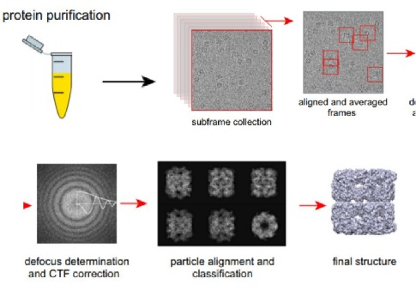

Cryo-electron microscope

Slide 26
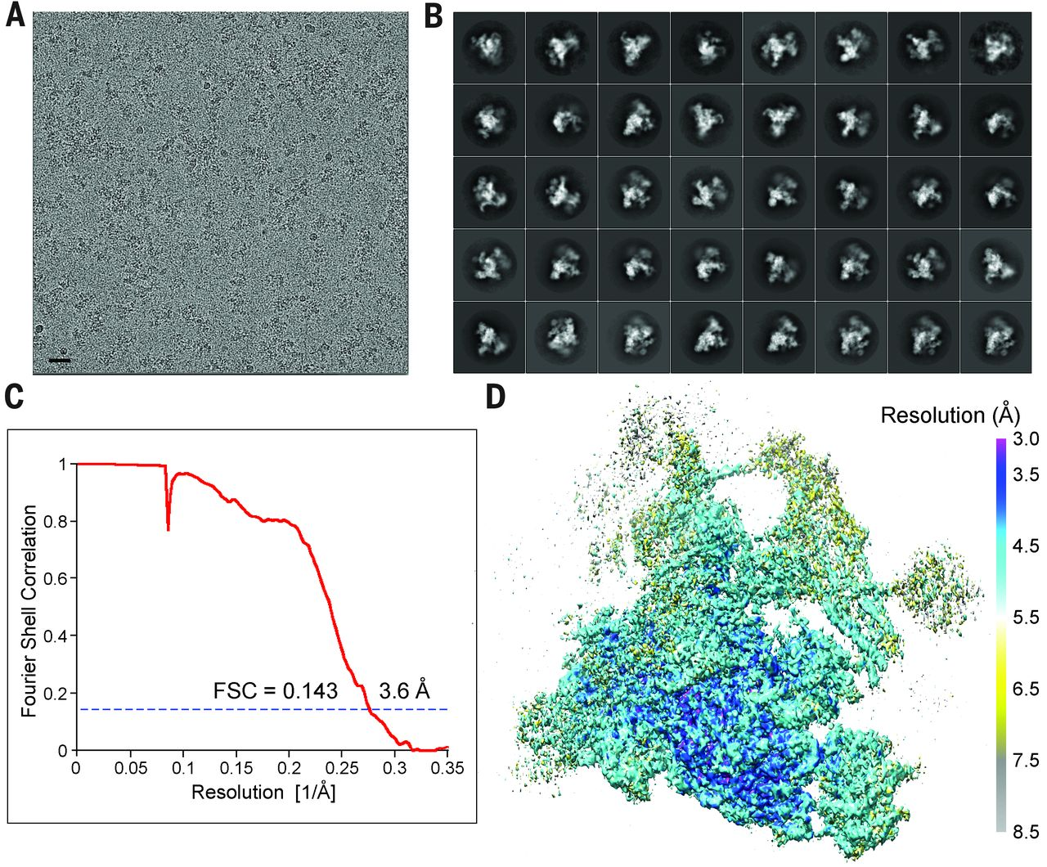
Structure of a yeast spliceosome at 3.6-angstrom resolution

Slide 27
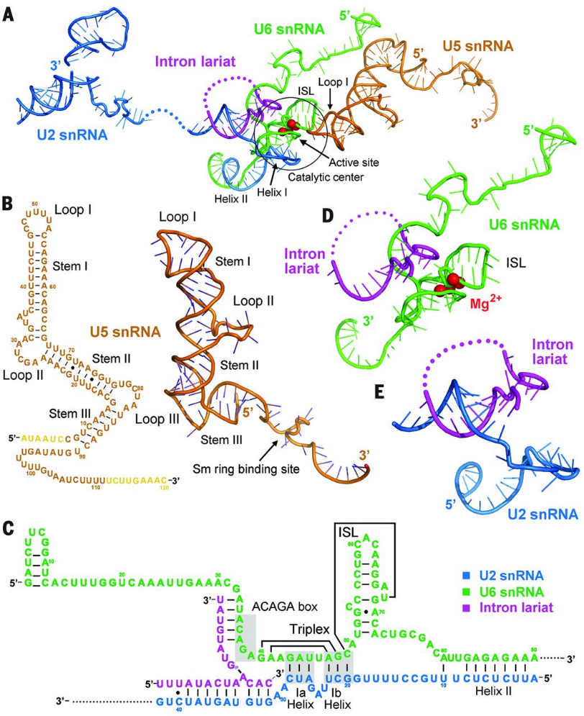







Slide 28
How are the reacting pieces placed into close proximity of one another in the correct temporal order?
Given the varying lengths of the exons and introns, how does the spliceosome accommodate pre-mRNA and hold the 5′-exon for both steps of the reaction?
What are the functions of the protein components of the spliceosome during the two-step reaction?

Slide 29



Organization of the RNA components

Slide 30
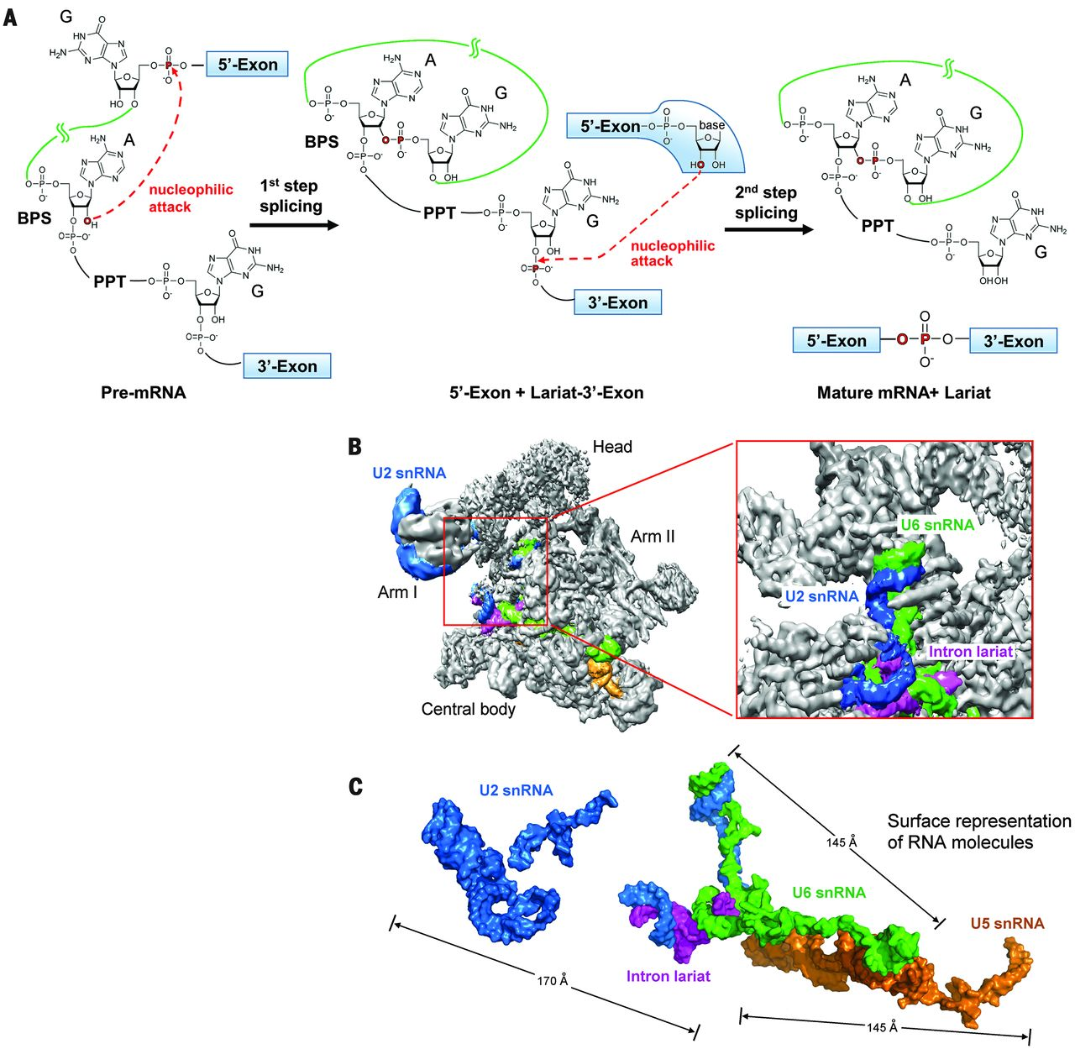
Organization of the RNA components

Slide 31


Organization of the RNA components

Slide 32
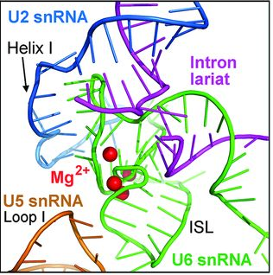
Catalytic center and active site

Slide 33
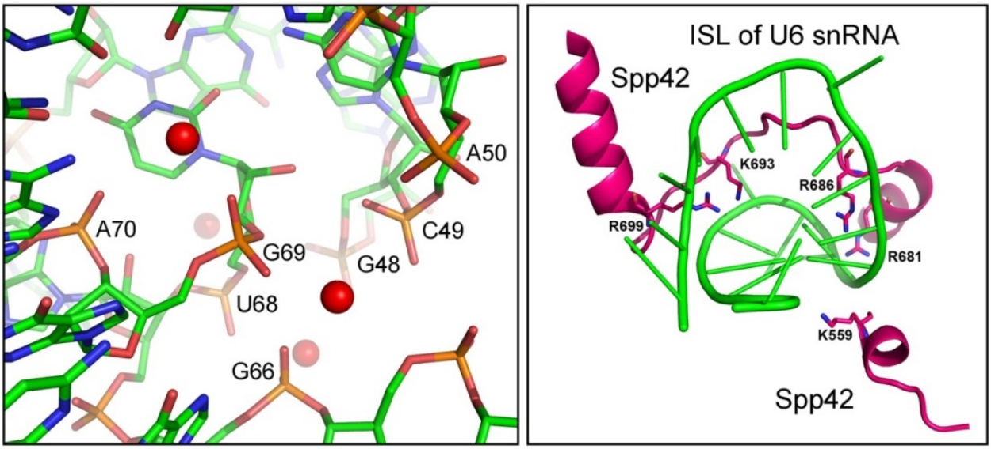
Catalytic center and active site

Slide 34
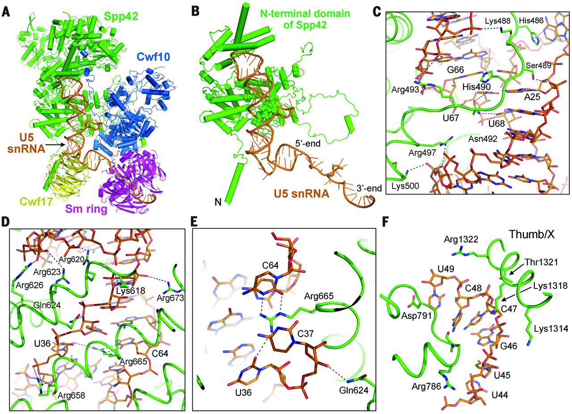
U5 snRNA and U5 snRNP

Slide 35
U5 snRNA and U5 snRNP

Slide 36
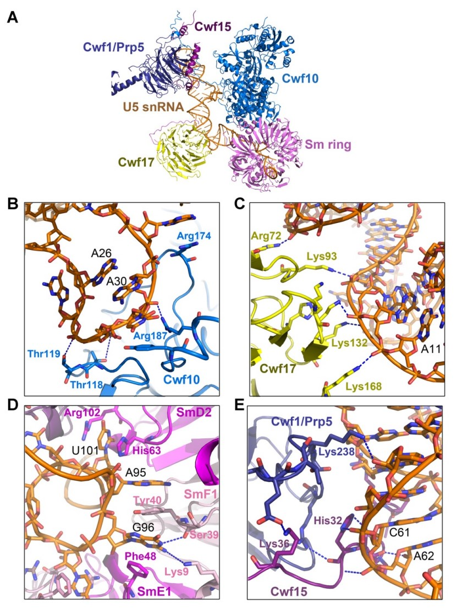
U5 snRNA and U5 snRNP

Slide 37
U5 snRNA and U5 snRNP

Slide 38
Placement of snRNA by
protein components
These proteins can be divided into two general categories: 1）enzymes exemplified by the RNA-dependent helicases/adenosine triphosphatases (ATPases)；
2）structural components that lack enzymatic activities
2）Functions of the enzymes well understood because alteration of an enzymatic activity frequently leads to a splicing defect at a specific stage of the reaction: mutations in the helicase Brr2 have a negative impact on the unwinding of the U4/U6 duplex, resulting in stalled activation of the spliceosome preceding the first-step reaction.
2）In contrast, the structural components of the spliceosome are less well understood because their mutations may either disrupt the spliceosomal assembly or remain functionally silent.

Slide 39
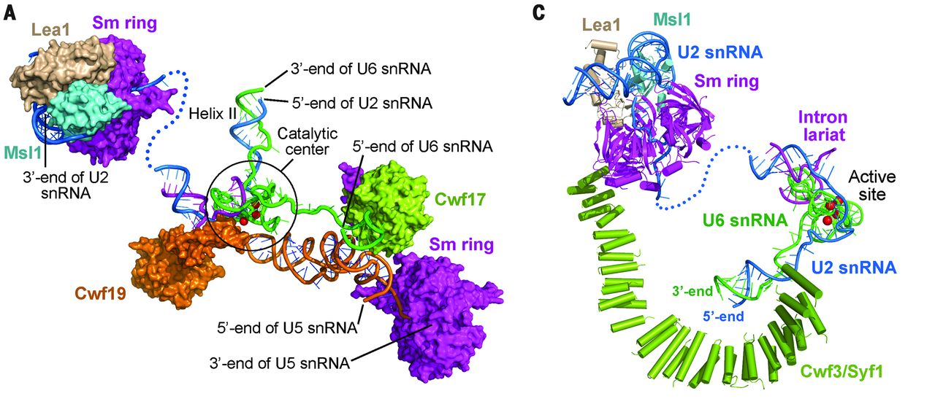
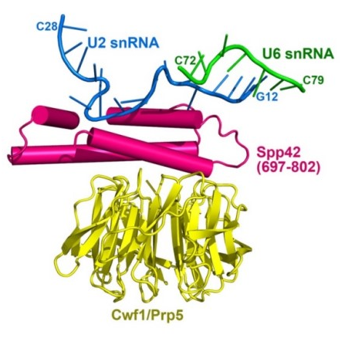
Placement of snRNA by
protein components
An important function of the structural components is to direct the key snRNA elements to the catalytic center while anchoring the ends of these snRNA molecules away from the catalytic center.
This arrangement may allow sufficient space for the enzymatic components, such as the RNP remodeling proteins, to exert their functions.

Slide 40
Placement of snRNA by
protein components
This arrangement allows for considerable flexibility and regulatory space between the catalytic center and the ends of snRNAs.

Slide 41
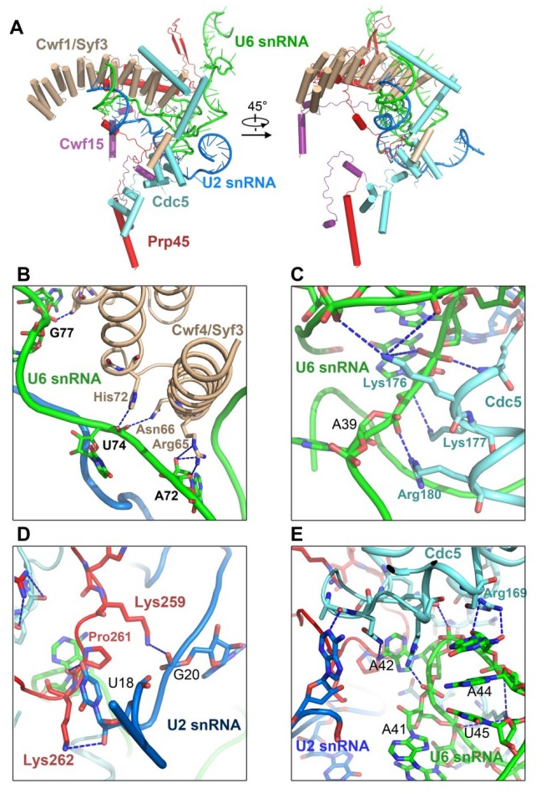
Placement of snRNA by
protein components

Slide 42
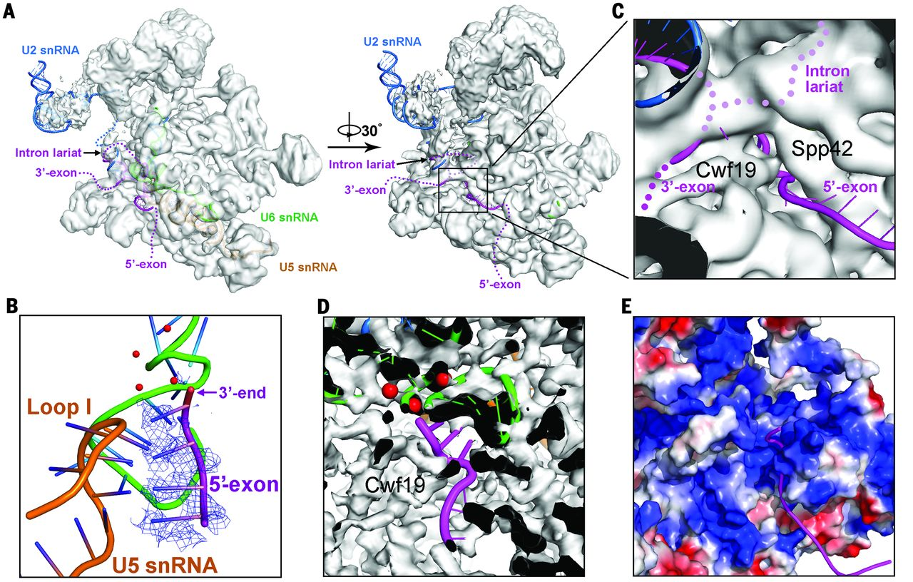
Putative location of the 5′-exon

Slide 43
Comparison with the group IIB self-splicing intron

Slide 44
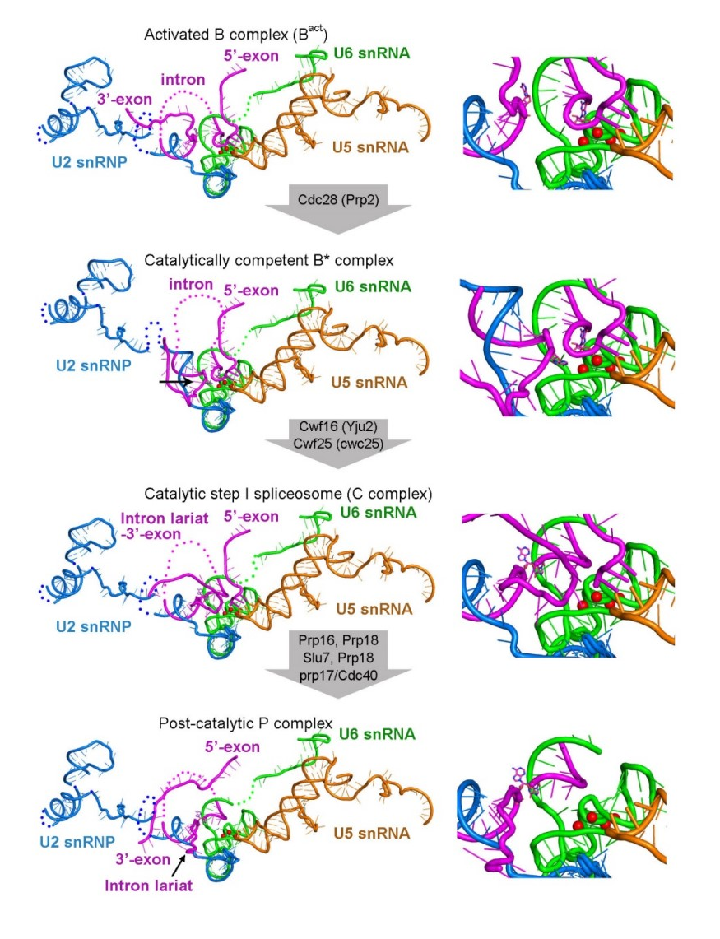

Discussion

Slide 45


Discussion

Slide 46
Discussion

Slide 47
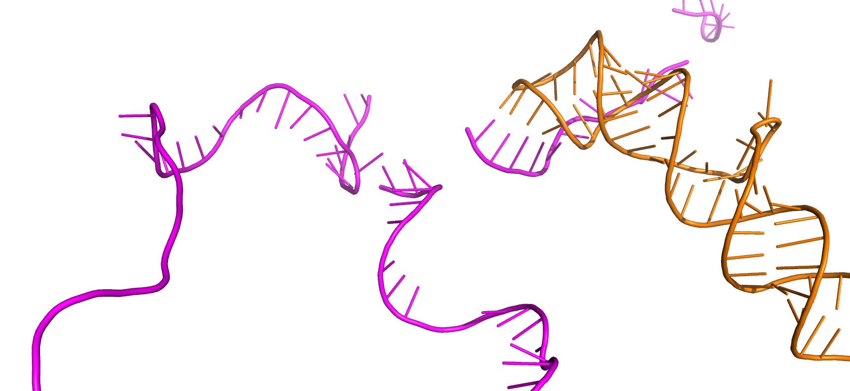
Discussion
Loop1 of U5
3’of 5’exon

Slide 48
Discussion
Our model predicts a generally similar overall architecture among the four functionally distinct spliceosomal complexes B^{act}, B*, C, and P. We further speculate that the splicing stage-specific factors and enzymes are recruited onto the generally similar spliceosomal complex to facilitate distinct stages of the splicing reaction.
Our structural analysis corroborates a large body of experimental observations:
U2/U6 three-way junction;
The U6 ISL, specified by the bulged uridine nucleotide; (the human spliceosome should also contain)
two-metal mechanism;
detailed predictions of the RNA network in the spliceosome;
Two differences.

Slide 49
Discussion
Structural determination of the yeast spliceosome at 3.6 Å resolution represents a major step forward for mechanistic understanding of the spliceosomal function.
Spliceosome is a protein-controlled ribozyme. The RNA-based catalytic center is assembled on the scaffold of Spp42 and U5 snRNP. The ends of the snRNA are anchored away from the catalytic center, and the intervening sequences between the snRNA ends and the catalytic center are directed by both structural protein components and RNP remodeling enzymes. Such a design likely optimizes the possibilities of regulation on the catalytic center and the splicing reaction. The collective action of the numerous protein components serves to deliver the critical pieces—5′SS, BPS, 3′SS, and 5′-exon—into the close proximity of the catalytic Mg²⁺ ions for catalysis.

Slide 50
References
Hang J, Wan R, Yan C, Shi Y. Structural basis of pre-mRNA splicing. Science. 2015;349(6253):1191-1198. doi:10.1126/science.aac8159
Yan C, Hang J, Wan R, Huang M, Wong CC, Shi Y. Structure of a yeast spliceosome at 3.6-angstrom resolution. Science. 2015;349(6253):1182-1191. doi:10.1126/science.aac7629
Zimmerly, S., Semper, C. Evolution of group II introns. Mobile DNA 6, 7 (2015). https://doi.org/10.1186/s13100-015-0037-5
Jurica MS, Moore MJ. Pre-mRNA splicing: awash in a sea of proteins. Mol Cell. 2003;12(1):5-14. doi:10.1016/s1097-2765(03)00270-3
Smith DJ, Konarska MM. A critical assessment of the utility of protein-free splicing systems. RNA. 2009;15(1):1-3. doi:10.1261/rna.1322709
Fica, S., Tuttle, N., Novak, T. et al. RNA catalyses nuclear pre-mRNA splicing. Nature 503, 229–234 (2013). https://doi.org/10.1038/nature12734
Wilkinson ME, Charenton C, Nagai K. RNA Splicing by the Spliceosome. Annu Rev Biochem. 2020;89:359-388. doi:10.1146/annurev-biochem-091719-064225

